Slide 1
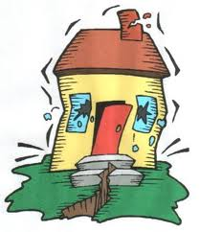
Welcome
to
Earthquake 101

Slide 2
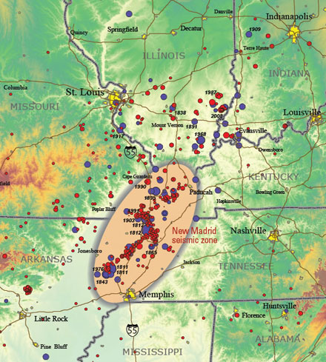
About 200 earthquakes occur in our region each year, mainly in southeast Missouri’s New Madrid Seismic Zone

Slide 3
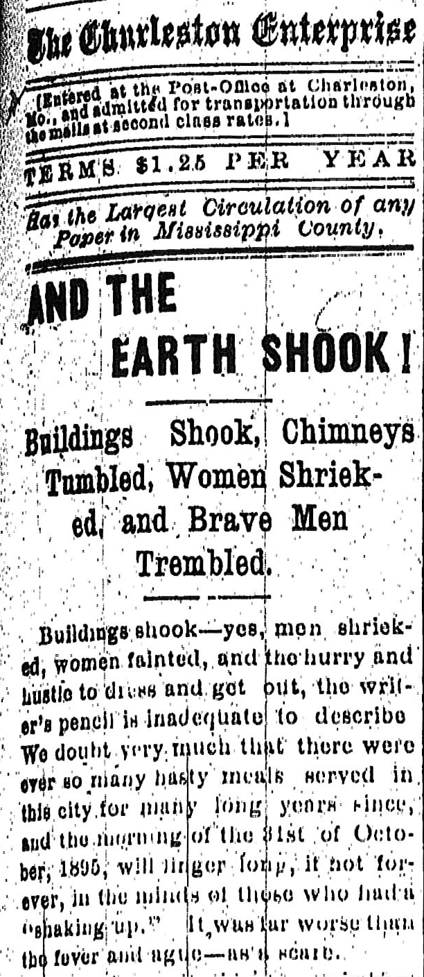
Missouri’s Great Quakes
Among the biggest earthquakes ever to hit the continental U.S.:
1811-1812: At least three giant quakes hit Missouri’s bootheel, destroying homes, changing the course of the Mississippi River, ringing church bells as far away as Boston, Mass.
Another big quake was centered in the southeast Missouri city of Charleston in 1895 (The Charleston Enterprise headline summed it up!)

Slide 4
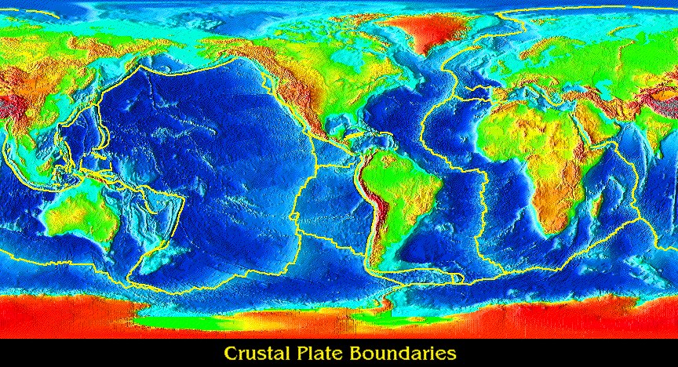
Earthquakes happen because the
ground is always moving
About 20 tectonic plates rub against each other,
floating above a layer of molten rock
Move about 5 inches per year (about as fast as our fingernails grow!)

Slide 5
The tectonic plates move against each
other, building up tension
Then a sudden movement of rocks occurs
The ground shakes as stress energy is released, and rocks snap into new positions
Shaking causes rocks to “snap”

Slide 6
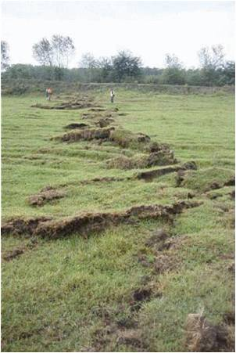
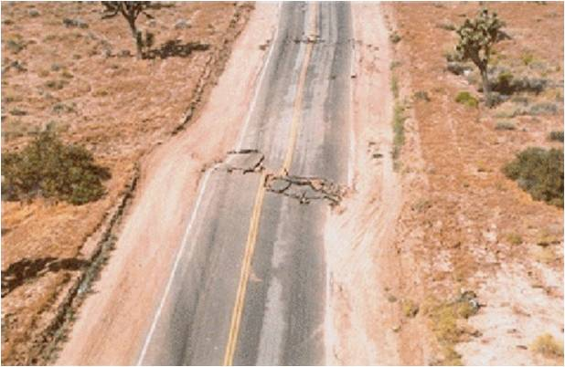
The rocks colliding causes earthquakes. Here’s graphic evidence of these collisions.

Slide 7
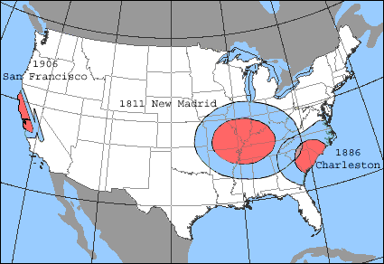
In the western U.S., rocks and mountains limit the spread of earthquake damage. But in our area, earthquake shock waves cause far greater damage.

Slide 8
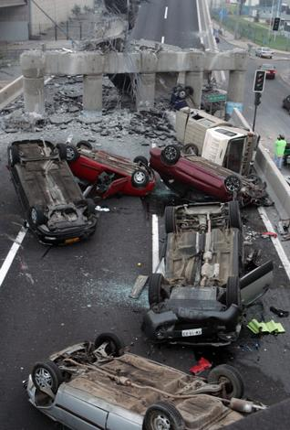
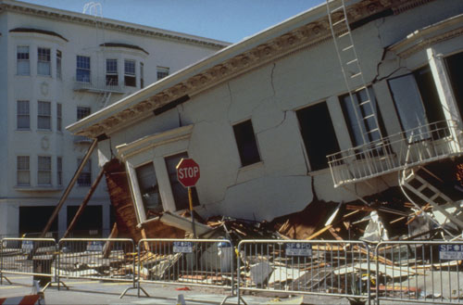
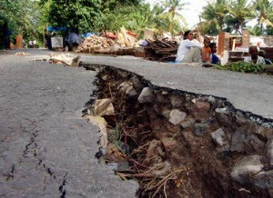
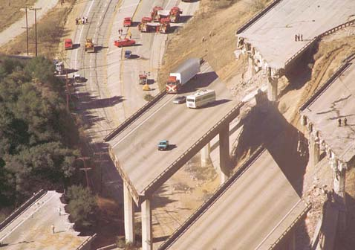
The biggest earthquakes cause devastating damage.

Slide 9
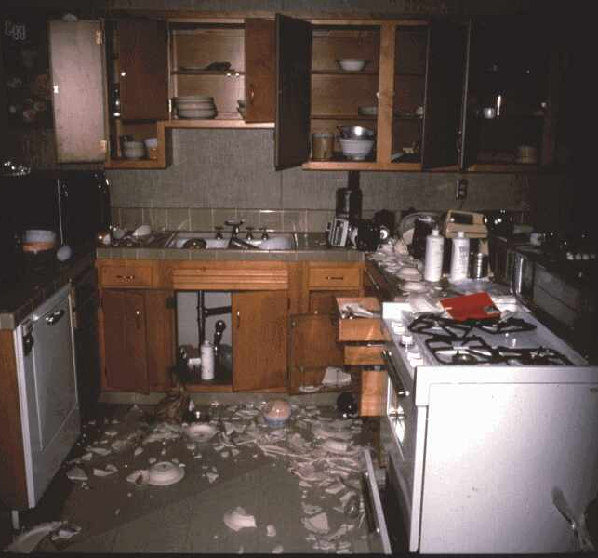
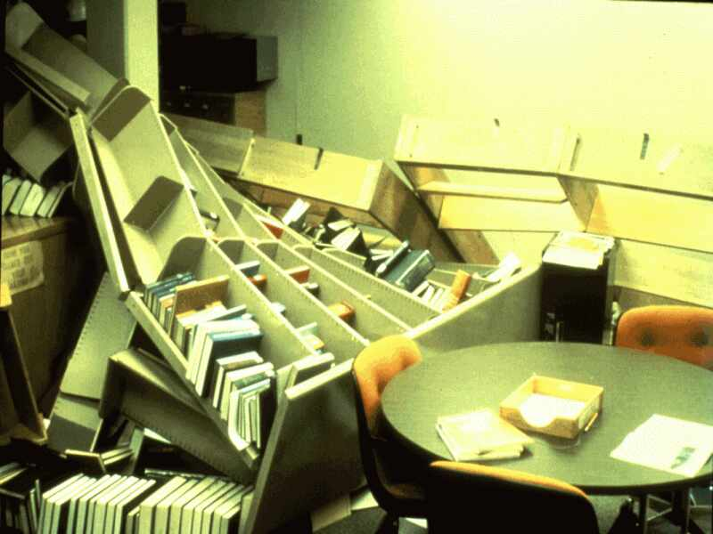
But there’s also danger when buildings don’t collapse!
At home
At school

Slide 10
Prepare BEFORE an earthquake happens
Put together an emergency kit – flashlight, first aid kit, radio, drinking
water, blankets
Develop a family communication plan – identify a relative living at least 100 miles away; everyone can call to “check in” to tell family you’re safe
Make sure all heavy or breakable items are on lower shelves
Know how to turn off utilities

Slide 11
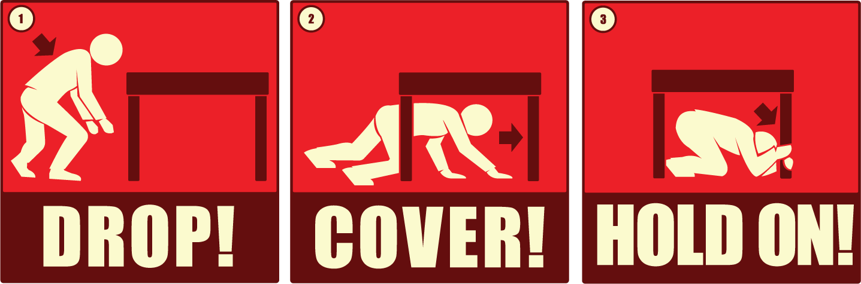
What do you do when a quake hits?
DROP to the ground.
COVER yourself under a sturdy table or desk, and cover your face and head with your arms.
HOLD ON to something sturdy until the shaking stops.

Slide 12

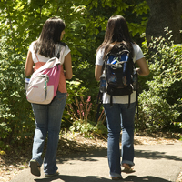
If you’re driving, pull off the road, away from buildings and utility poles, and stay in your car.
If you’re outside, drop to the ground, away from large objects, and cover your face and head with your arms.

Slide 13
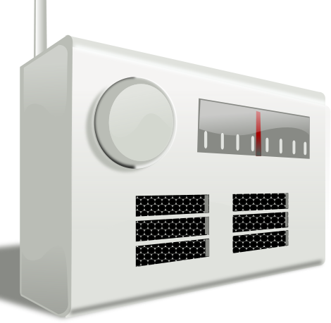
After the quake hits:
Find your family; check for injuries
If necessary, call 911 for help
If you smell gas or hear a hissing sound, go outside – shut off gas valve
Be careful to avoid live power lines and broken glass
Listen to news for latest emergency information
Be ready for aftershocks!

Slide 14

If you have a plan and know what
to do, you can help your family
stay safe in an earthquake!

