Slide 1

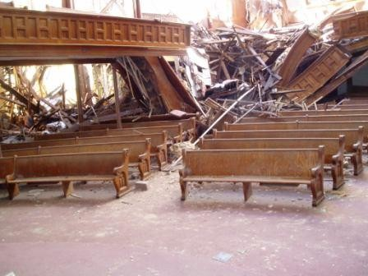
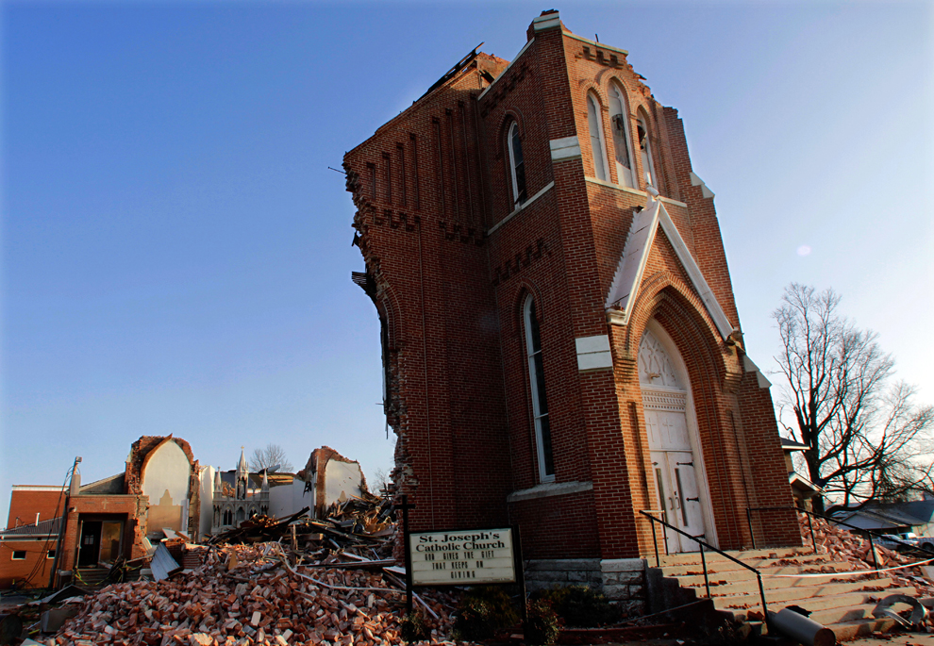
Preparing your Church and
Congregation for Severe Weather
Andy Bailey National Weather Service
Kansas City/Pleasant Hill, Missouri
Notes:
Done

Slide 2
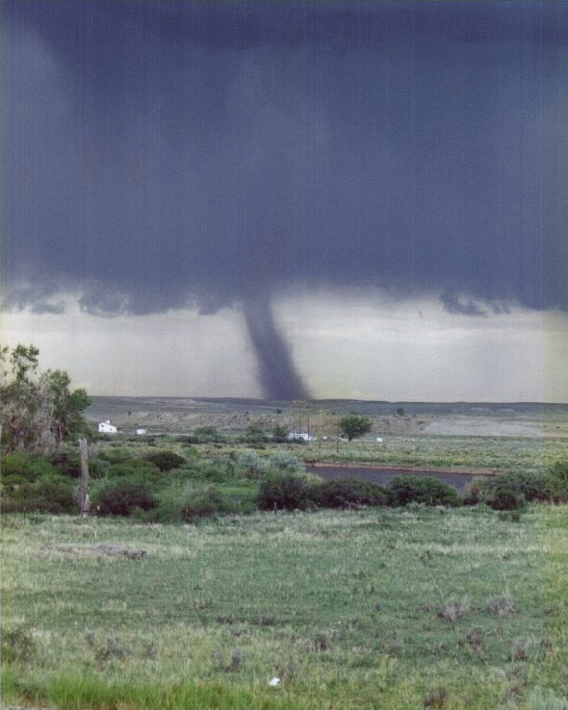
Agenda
Palm Sunday Tornado Video
Severe Weather Trends
Watches, Warnings, and Your Plan
Severe Weather Outlook
Notes:
Go through the agenda for the talk

Slide 3
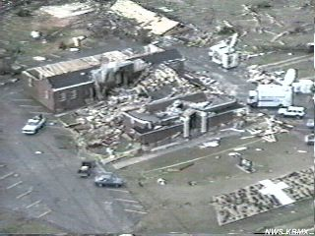
Palm Sunday Tornado strikes
northeast Alabama Church

Slide 4
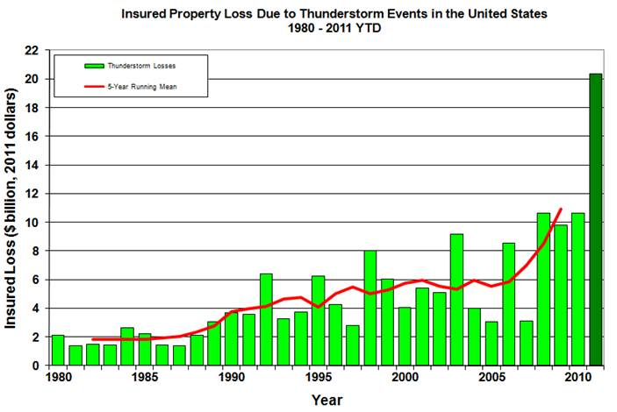
U.S. Thunderstorm Related Losses
Notes:
Ask the question…do we get much severe weather? Here? How about last year. Then show the graphic and explain it.

Slide 5
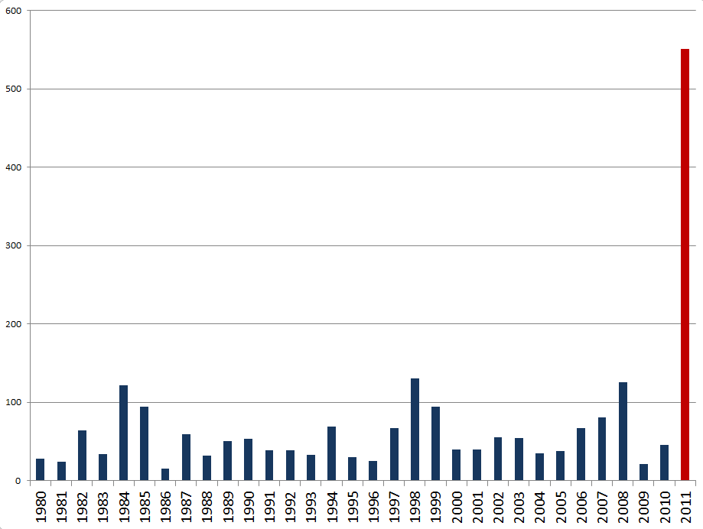
U.S. Tornado Fatalities by Year

Slide 6
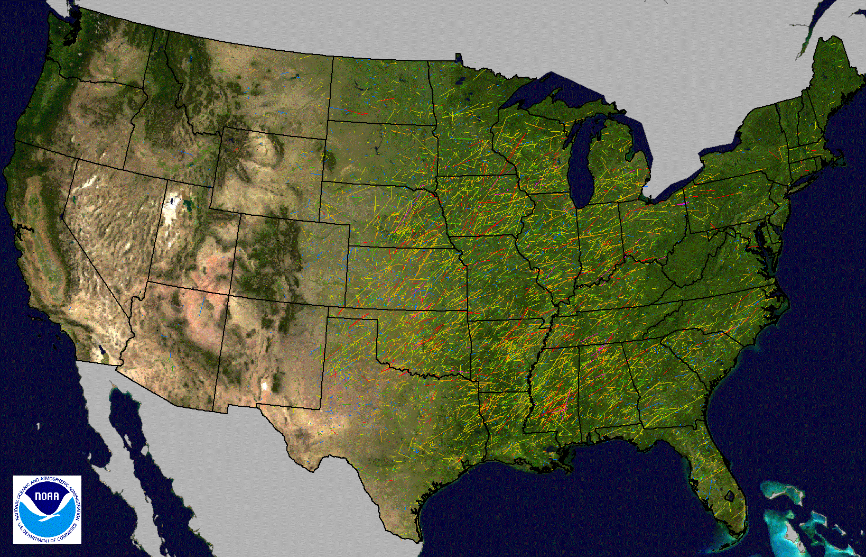
Documented Tornadoes Since 1950
Notes:
This depicts the tracks of documented tornadoes since 1950. This is just to show that tornados happen anywhere and everywhere through the lower Ohio and middle Mississippi River areas.

Slide 7
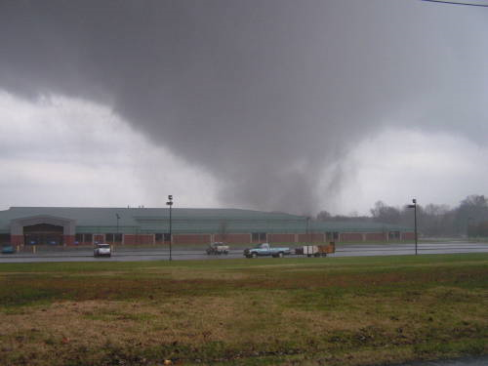
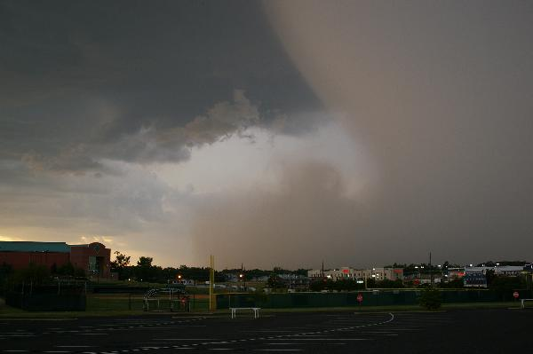
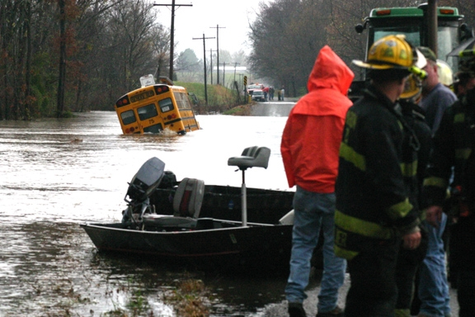
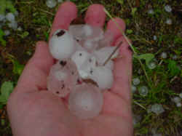
Severe Weather Events
Tornado
Straight Line Winds (58 mph or greater)
Flash Flood
Hail (1” or larger)
Lightning
Notes:
Severe weather in our area includes: tornadoes, straight line winds of 58 mph or greater, flash floods, and hail greater than one inch. Lightning is not considered “severe weather”. Lightning by definition occurs with all thunderstorms but this should not diminish its danger.

Slide 8
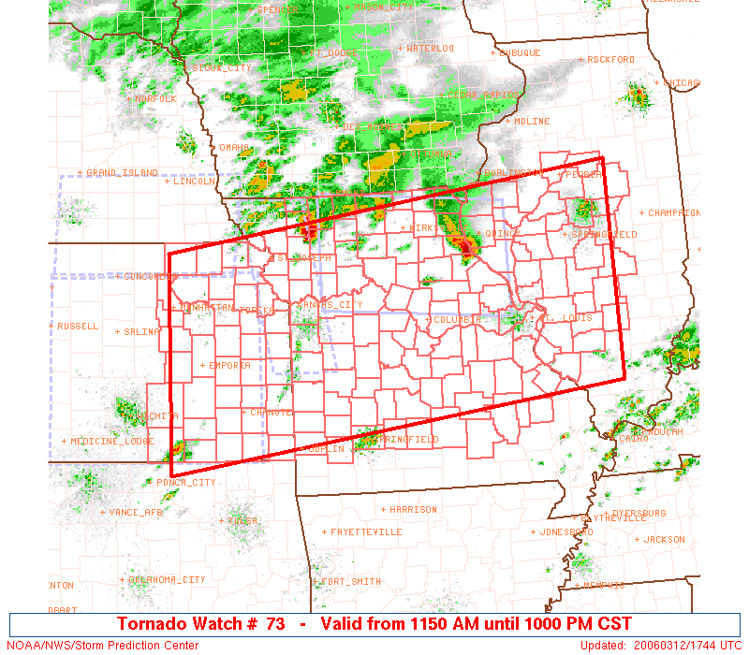
Severe Weather Watch
Notes:
Talking points: Watches are issued for large areas covering many counties. Typically issued before storms initiate and are valid through the expected event. Example shown is from the late morning of march 12th (PDS Tornado box for the afternoon/evening). Mouse click will switch to the text version of the product. Note PDS wording – Situational Awareness means an extremely heightened threat of severe weather.

Slide 9
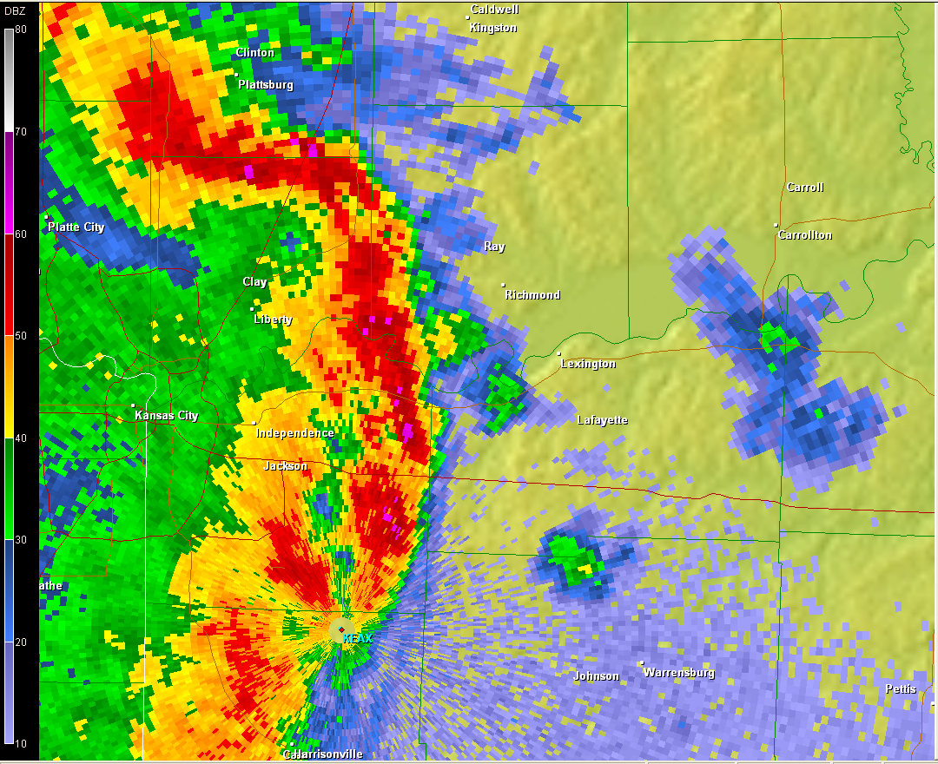
Severe Weather Warning
Notes:
Talking points: Warnings are storm driven events that urge people to take immediate action to protect life or property. Average valid time is 30 to 60 minutes for very specific areas. Point out polygon warnings

Slide 10
Impact Based Warning Experiment
Not trying to scare
Enhanced wording which matches threat
  Paint a realistic picture of potential impacts

Slide 11
Example “Base” Tornado Warning
SIGNIFICANT HOUSE AND BUILDING DAMAGE POSSIBLE. MOBILE HOMES COMPLETELY DESTROYED IF HIT. SOME TREES UPROOTED OR SNAPPED. VEHICLES WILL LIKELY BE THROWN BY TORNADIC WINDS.

Slide 12
Example “Enhanced” Tornado Warning
MAJOR HOUSE AND BUILDING DAMAGE LIKELY AND COMPLETE DESTRUCTION POSSIBLE. NUMEROUS TREES SNAPPED. MAJOR POWER OUTAGES IN PATH OF TORNADO HIGHLY LIKELY. SOME ROADS POSSIBLY BLOCKED BY TORNADO DEBRIS. COMPLETE DESTRUCTION OF VEHICLES LIKELY.

Slide 13
Example Tornado Emergency
THIS IS A LIFE THREATENING SITUATION. YOU COULD BE KILLED IF NOT UNDERGROUND OR IN A TORNADO SHELTER. COMPLETE DESTRUCTION OF ENTIRE NEIGHBORHOODS IS LIKELY. MANY WELL BUILT HOMES AND BUSINESSES WILL BE COMPLETELY SWEPT FROM THEIR FOUNDATIONS. DEBRIS WILL BLOCK MOST ROADWAYS. MASS DEVASTATION IS HIGHLY LIKELY MAKING THE AREA UNRECOGNIZABLE TO SURVIVORS.

Slide 14

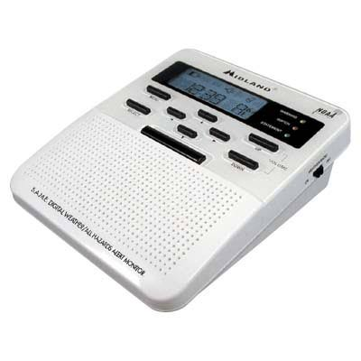
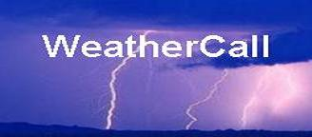

How Will You Be Alerted?
Notes:
Of course we will mention NWR, but we also need to stress that there are numerous other ways to get warnings, some better than NWR
NOAA Weather Radio
weathercall.net
Code Red / Rvrs 911
Smart Phone apps
RSS feeds/Twitter

Slide 15
Your Plan, Things to Consider
How will you communicate plan to congregation?
How will you receive warnings?
Who is your “weather watcher”?
Where will you shelter?
When will you postpone/cancel events?
Will you build safer shelter areas in future building/expansion?
Consult with local emergency manager

Slide 16
At Home Your Congregation Should:
Identify the safest shelter
  (lowest level, interior room)
Discuss with everyone in the house
Have ways to receive warnings
  NWR, weather call, code red, etc.
Seek shelter when appropriate

Slide 17
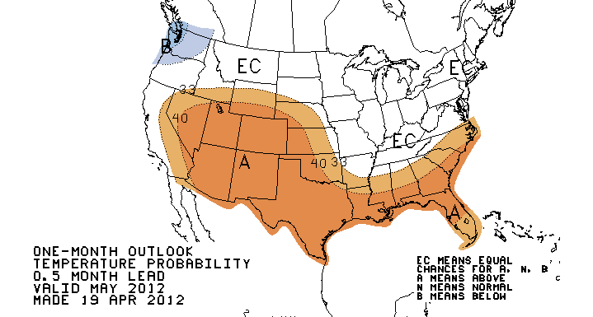
Outlook-Temperatures

Slide 18
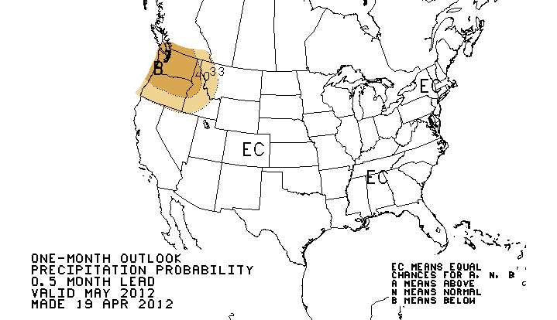
Outlook-Precipitation

Slide 19
Thank you!
http://weather.gov/kc
andy.bailey@noaa.gov
Notes:
Radar data is also there, free of charge. You can also check out other radar sites across the region and country. THE END!

