Slide 1
Continuity of Operations
Keeping your faith community safe & together

Slide 2
FBO’s and Emergency Services
Anticipating and meeting unmet needs . . . together
A natural fit based upon shared core values

Slide 3
“To welcome the stranger . . .”

Slide 4
“To Serve and Support . . .”

Slide 5
“To Demonstrate . . . “

Slide 6
When Disasters Occur
“How do we connect?”
“Where do we meet?”
“Who’s in charge?”
“Is there a Plan B?”
“Who knows about our Plan B?”

Slide 7
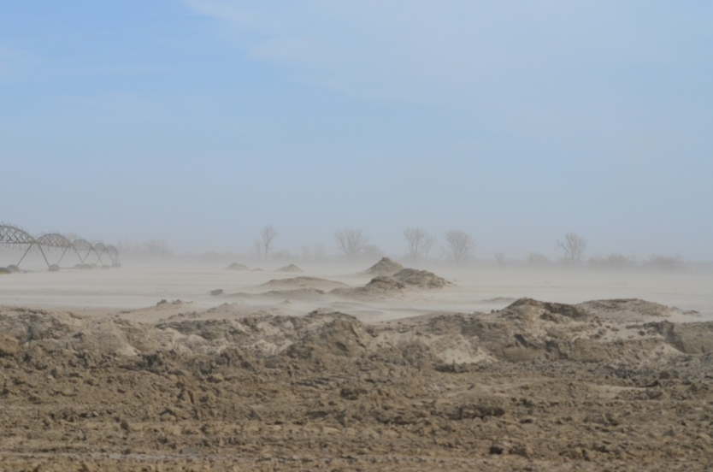
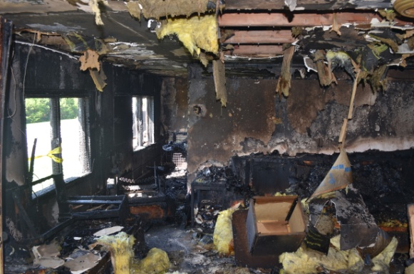
Types of Disasters
Natural
Tornado
Ice Storm
Flooding
Earthquake
Produced
Hazardous Material Spill
Power Outage
Fire
Terrorism

Slide 8
Scope of Disasters
Local
Regional
National
World Wide

Slide 9
What is Continuity Planning?
Continuity Planning is proactive planning to keep going through the “what ifs” and “just in cases” that your faith community will face.

Slide 10
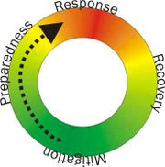
Disaster Cycle

Slide 11
Mitigation
Taking steps to reduce vulnerability to disasters
Install a safe shelter
Secure items likely to fall during an earthquake

Slide 12
Preparedness
Understanding how a disaster might impact us, creating plans, educating
Classes on preparing emergency survival kits
Knowing how utilities can be turned off or back on

Slide 13
Response
Address immediate threats caused by disaster
Safety & Health
Obstacles to resume organizational functioning

Slide 14
Recovery
Restoring full operational capacities
Short-term
Repair or relocate meeting place
Long-term
Resume or modify key community outreach missions

Slide 15
Questions to Ask
What are the potential hazards your community may face?
What are the impacts to your faith community?
What are the potential impacts to your facility?

Slide 16
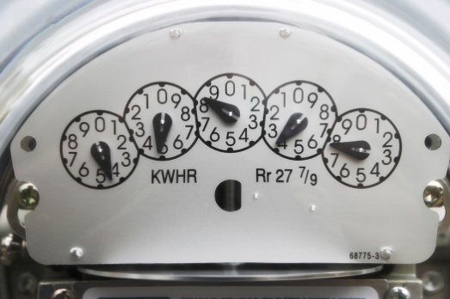
Factors to Consider
Historical – what types of emergencies have occurred in the community, at this facility and at other facilities in the area?
Geographic – What can happen as a result of the facility’s location?
Technological – What could result from a process or system failure?

Slide 17
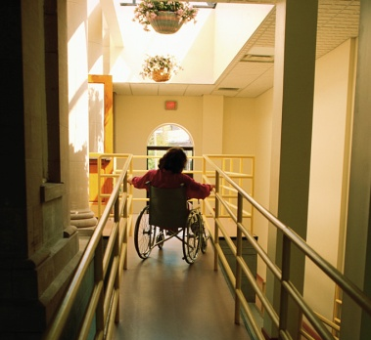
More Factors to Consider
Human Error – What emergencies can be caused by employee error?
Physical – what types of emergencies could result from the design or construction of the facility? Does the physical facility enhance safety?
Insurance – Are we covered for this?

Slide 18
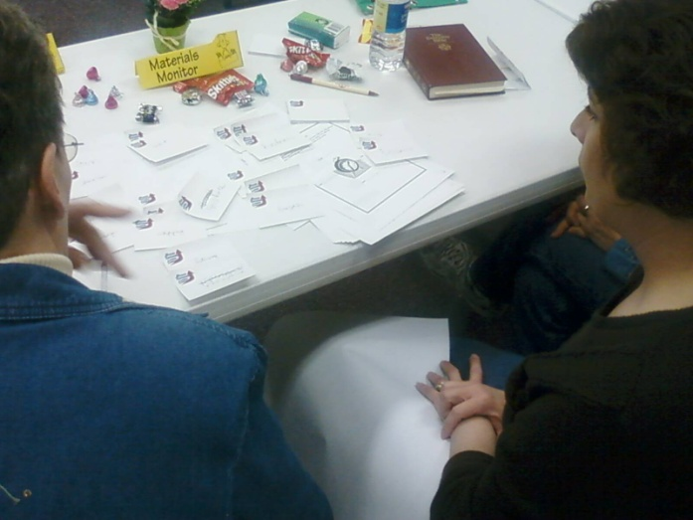
Conduct a Hazard Analysis
List all potential emergencies that could strike
Give each one a score of 1 to 5 based on the chance it may happen.
Score again based on human, property and organization impact
Score on resources
Total = which to work
on first

Slide 19
Vulnerability Analysis Chart
Hazard/Emergency Internal/External | Probability | Human Impact | Property Impact | Community Impact | Internal Resources | External Resources | TOTAL
 | 5 1 | High Impact 5 1 Low Impact |  |  | 5 1
Tornado | 4 | 5 | 5 | 4 | 4 | 1 | 23
Fire | 2 | 2 | 5 | 2 | 2 | 1 | 14
Haz Mat | 1 | 3 | 1 | 4 | 5 | 1 | 15
Power out | 5 | 4 | 3 | 4 | 5 | 3 | 23
High Low
Weak Resources Strong Resources
Notes:
Hazards – see page 49 of booklet

Slide 20
Working Backwards
Identify the biggest problem
Determine what can reduce the risk or problem? Work all the way through all possible solutions
Begin a process to reduce the risk/problem
No power = Big problem
Find a generator solution

Slide 21
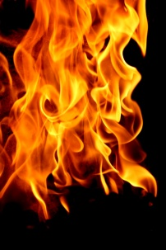
The Snowball Effect
Bank’s vulnerability analysis concluded that a “small” fire could be as catastrophic to the business as a computer system failure. The planning group discovered that bank employees did not know how to use fire extinguishers, and that the bank lacked any kind of evacuation or emergency response system.

Slide 22
People First!
How many people are in the building (weekdays, nights, services & special events)
Evacuation and rally points
Anyone living on-site?
Access and functional needs of your employees/members
During times of operation
Non-operational times (night)
Other community services you provide

Slide 23
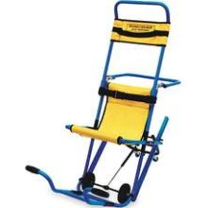
People First!
Is there any special equipment you may need?
Evacuation Chairs
Stretchers
Medical Kits
Do you have a system to check on elderly or infirm members of your congregation?

Slide 24
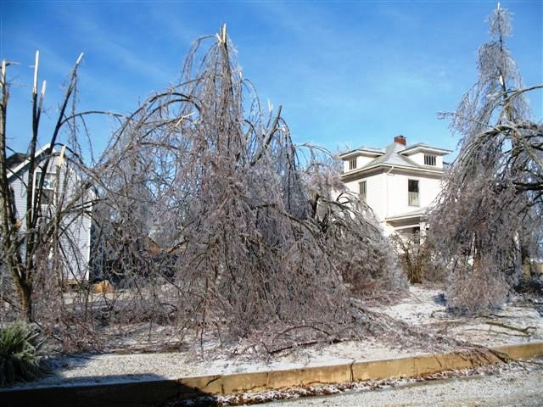
Putting the Plan Together
No single plan fits all organizations
Keep it simple
Use short declarative sentences. Don’t confuse anyone who may already be in a panic during an emergency situation.
Big Committee
One author

Slide 25
Address the 5 Key Elements
Response – Life Safety (most important)
Recovery of work area and resources
Resumption of business functions
Reconstruction of damaged facility
Relocation back to facility (if moved)

Slide 26
Plan Components
Executive Summary
Emergency Management Elements
Emergency Response Procedures
Support Documents
Notes:
Emergency management elements describes the organization's approach to emergency management
Emergency Response Procedures describes how the organization will respond to the event

Slide 27
Support Documents
Emergency Call Lists
Building and Site maps
Resource Lists
Checklists by department

Slide 28
Coordination
Coordinate with your local Emergency Management Director
Coordinate with your Fire Chief
Coordinate with your Police Chief
Coordinate with the local
Red Cross

Slide 29
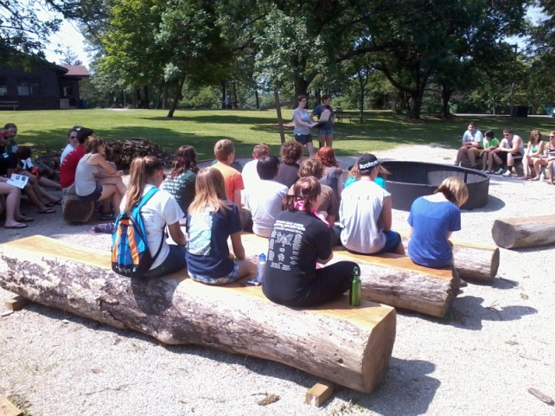
Review the Plan
After Each Exercise
After Each Emergency
When Personnel Change
When Responsibilities Change
When Facility Changes
When Policies / Procedures Change

Slide 30
Are you Prepared?

Slide 31
Sources of Information
Institute for Business & Home Safety ibhs.org
University of Missouri extension.missouri.edu/cemp/
State Emergency Management Agency sema.state.mo.us
FEMA fema.gov
Dept. of Homeland Security Ready.gov
American Red Cross redcross.org
Notes:
The American Red Cross site offers:
Copy of FEMA’s “Emergency Management Guide for Business & Industry” and “Open for Business” a disaster planning toolkit

Slide 32
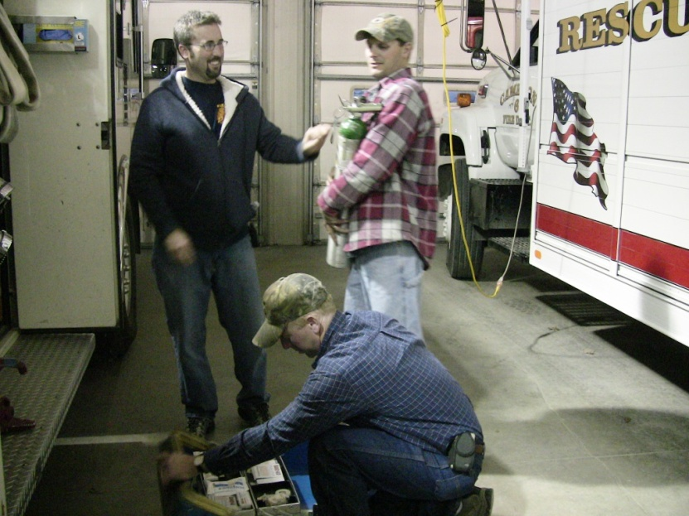
What First Step Will YOU Take?
For Your Faith Based Organization
For Your Community

