Slide 1
Long-Term Recovery Committee. . .extras
Shared information from
Stephanie A. Norton, Deputy Director
Franklin Co. Emergency Management Agency
3 Bruns Lane, Union, MO 63084
636-583-1679
sanorton@franklinmo.gov

Slide 2
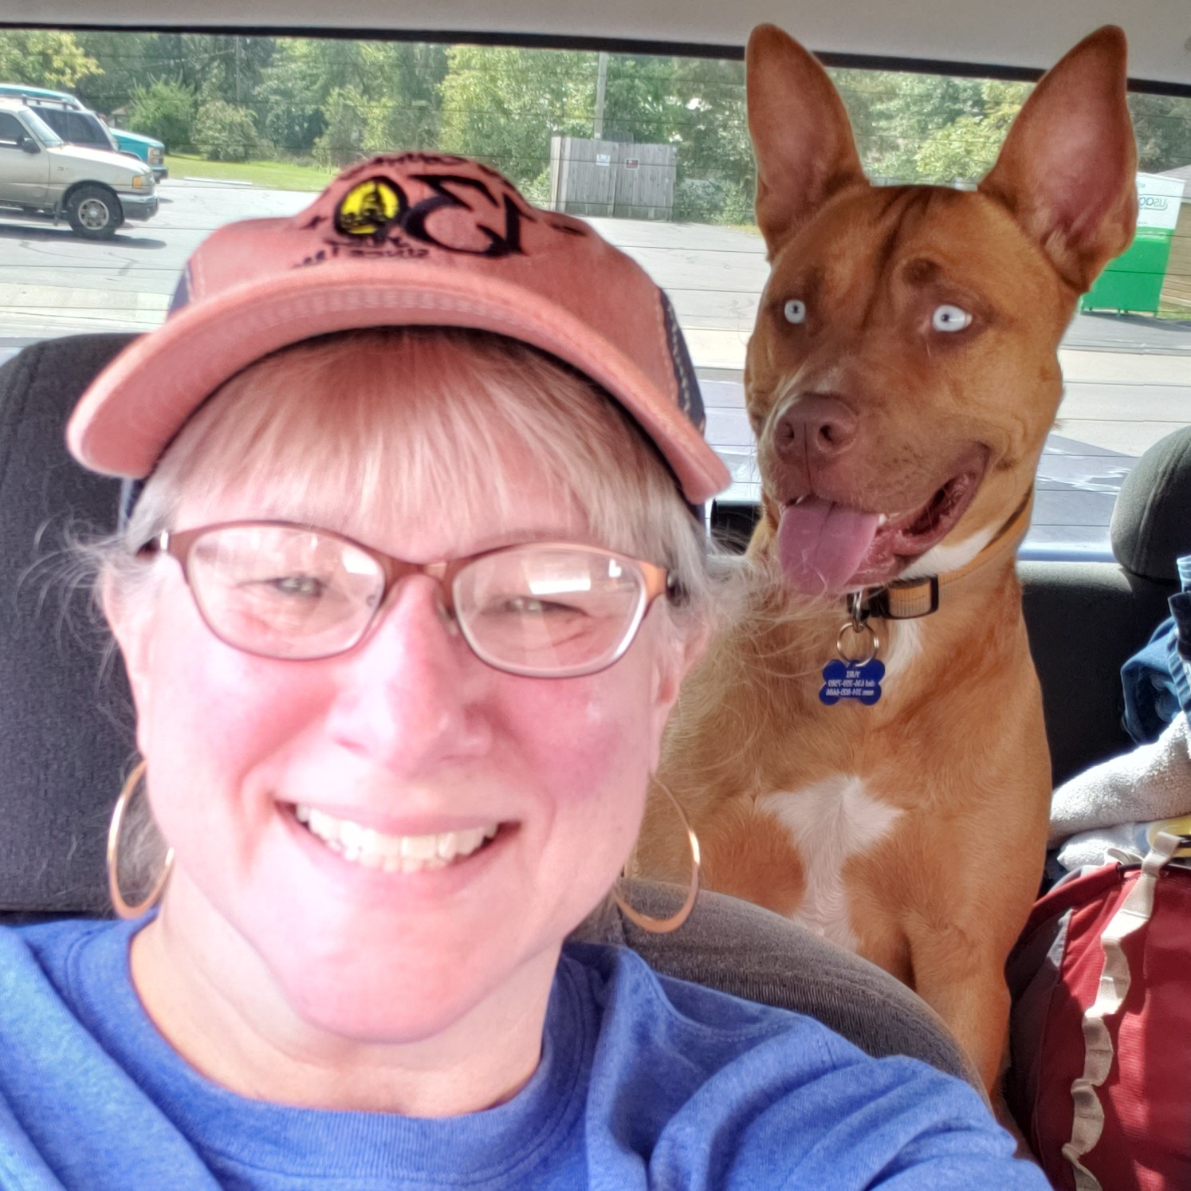
Stephanie A. Norton
I am the Deputy Director of the Franklin County Emergency Management Agency. I have been with FCEMA since May 2007.
In October 2013, we started the Franklin County Community Organizations Active in Disaster (COAD). I currently serve as the Chair of the FCCOAD as well as our regional COAD in the St. Louis Urban Area Security Initiative (UASI) region – the St. Louis Area Regional Coalition of COADs (SLARCC).
I am a member of the Missouri Voluntary Organizations Active in Disaster (MoVOAD) where I am chair of the Training Committee and Co-Chair of the Animals in Disaster Planning Advisory Committee (ADPAC).
I have participated on three local Long-Term Recovery Committees following flooding in Franklin County in March 2008, December 2015, and April 2017. You also may have seen me at a Multi-Agency Resource Center (MARC) in Missouri – helping outside of Franklin Co. when available.
The following PowerPoint slides include LTRC information I have shared through other presentations. Some of the information may be beneficial to your committee/group, while other information may be interesting (stats)!
Stephanie and her dog, Yuri

Slide 3
Presented to the Franklin County Service Providers in July 2017
We were in Long-Term Recovery (LTR) for the December 2015 flooding (DR-4250) at the time of this presentation. Though we experienced additional historical flooding in April 2017 (DR-4317), the LTR for that event did not officially start until January 2018. Immediate needs were addressed in a timely manner, but many homes experienced flooding in both 2015 and 2017. Through FEMA and the Disaster Case Management process – the damages from the two floods had to be addressed separately.

Slide 4
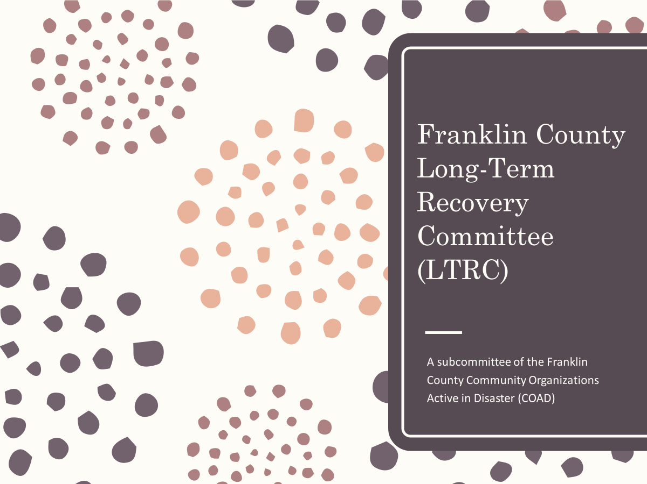

Slide 5
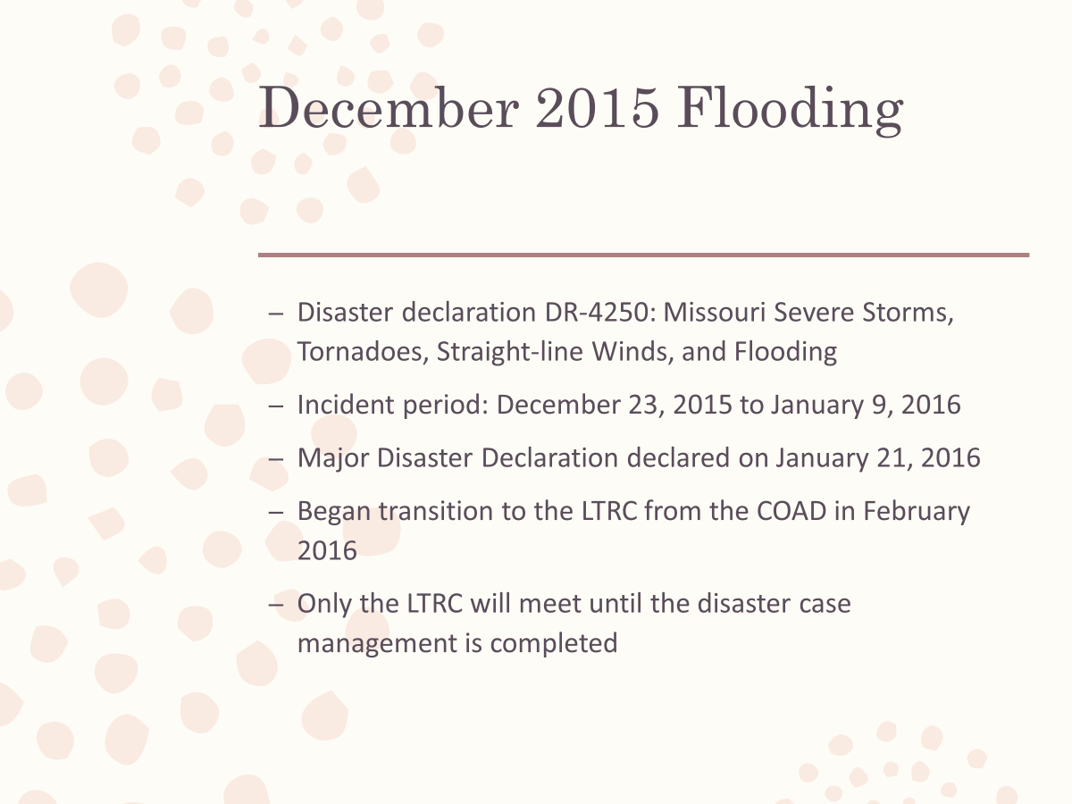

Slide 6
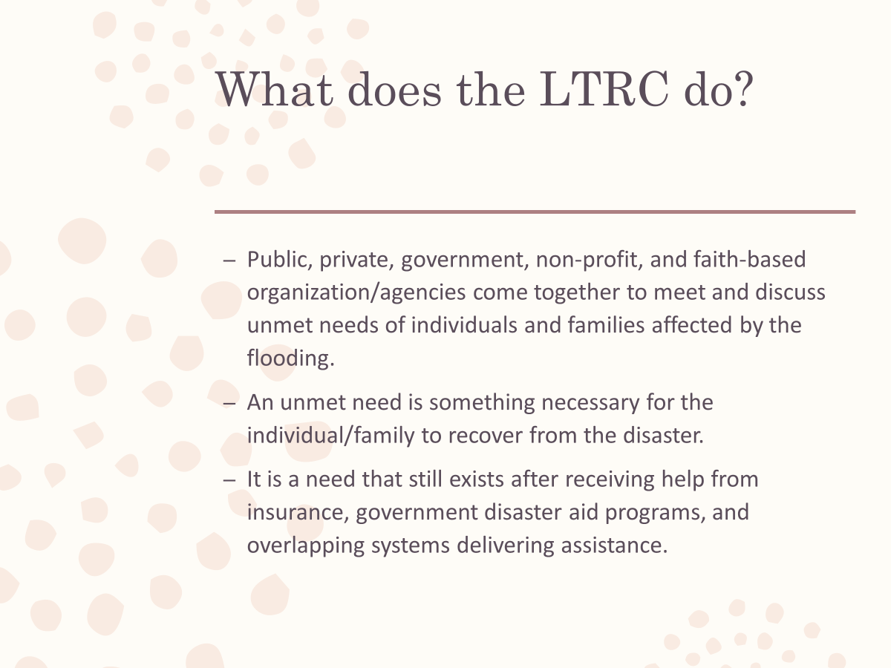

Slide 7
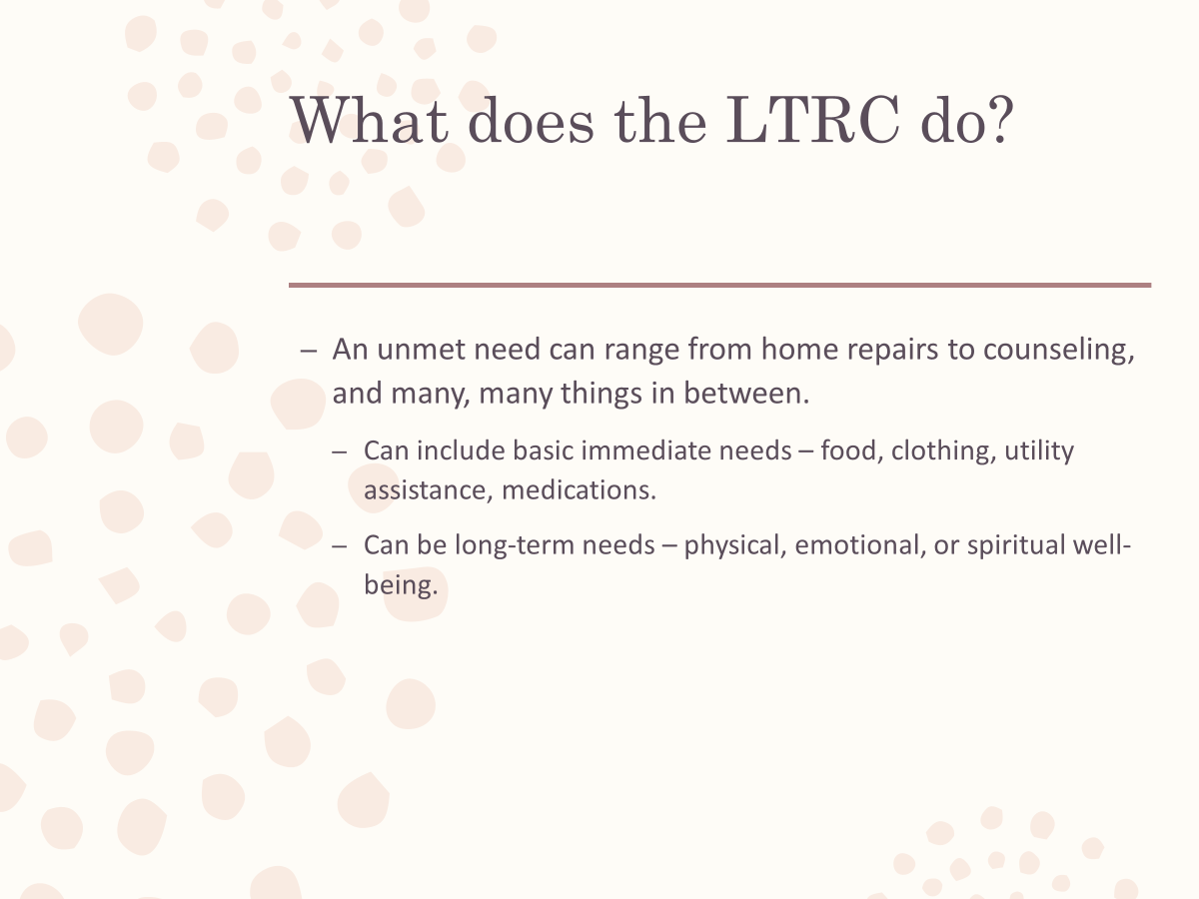

Slide 8
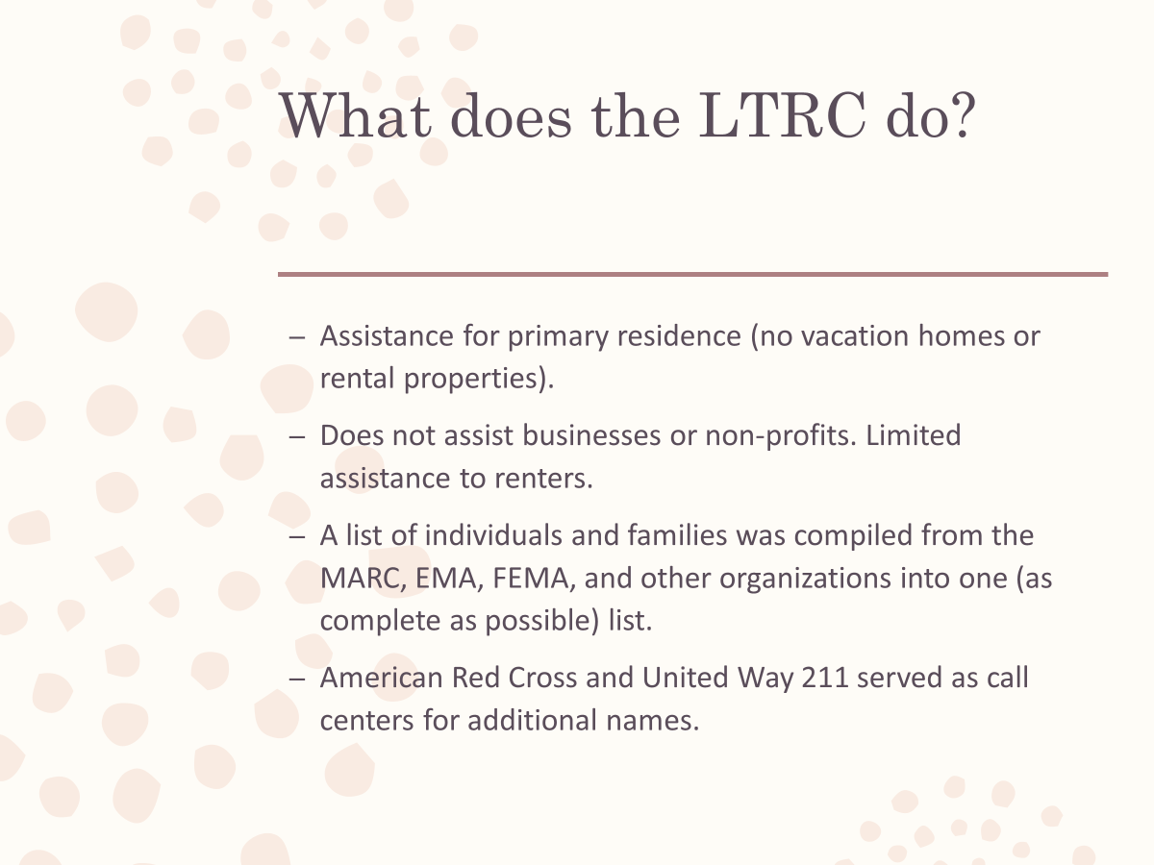

Slide 9
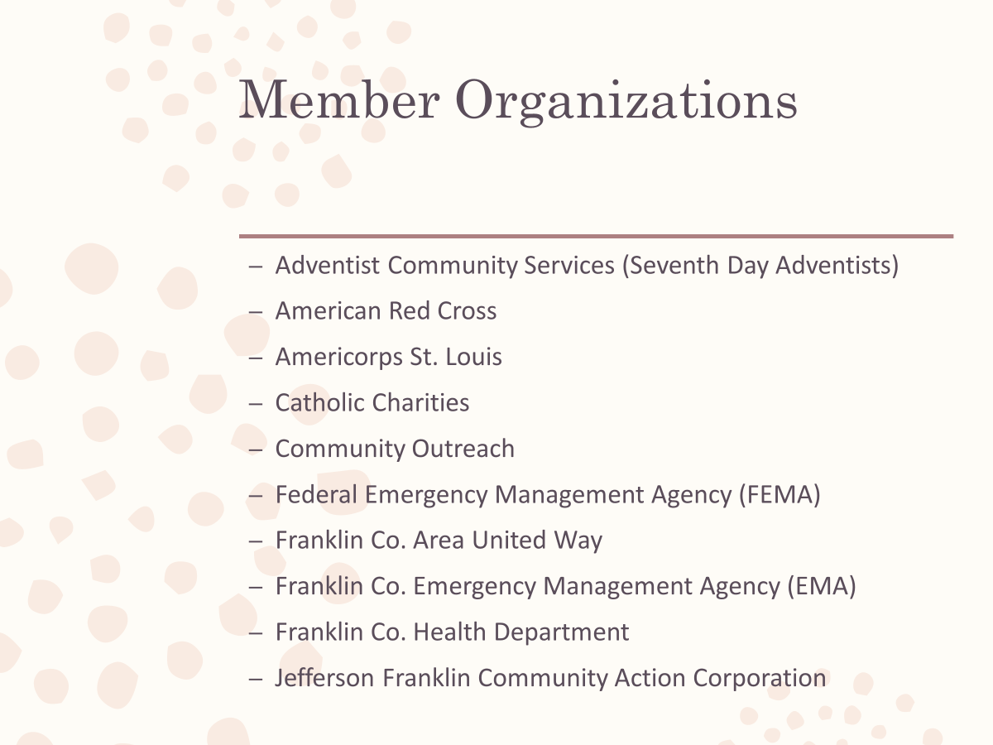

Slide 10
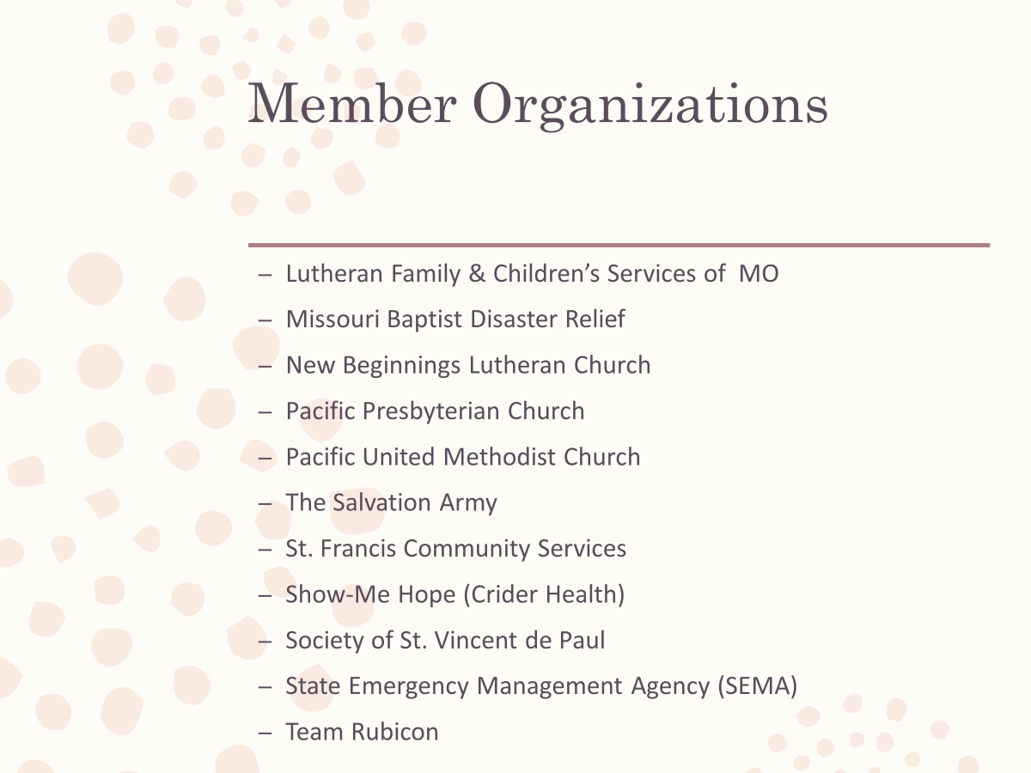

Slide 11


Slide 12
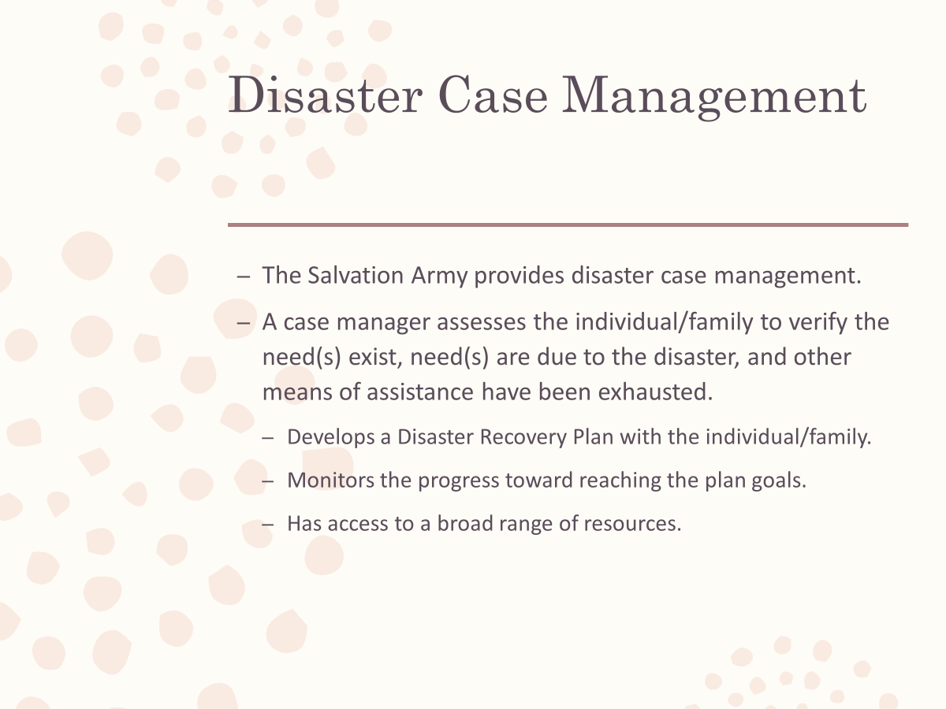

Slide 13
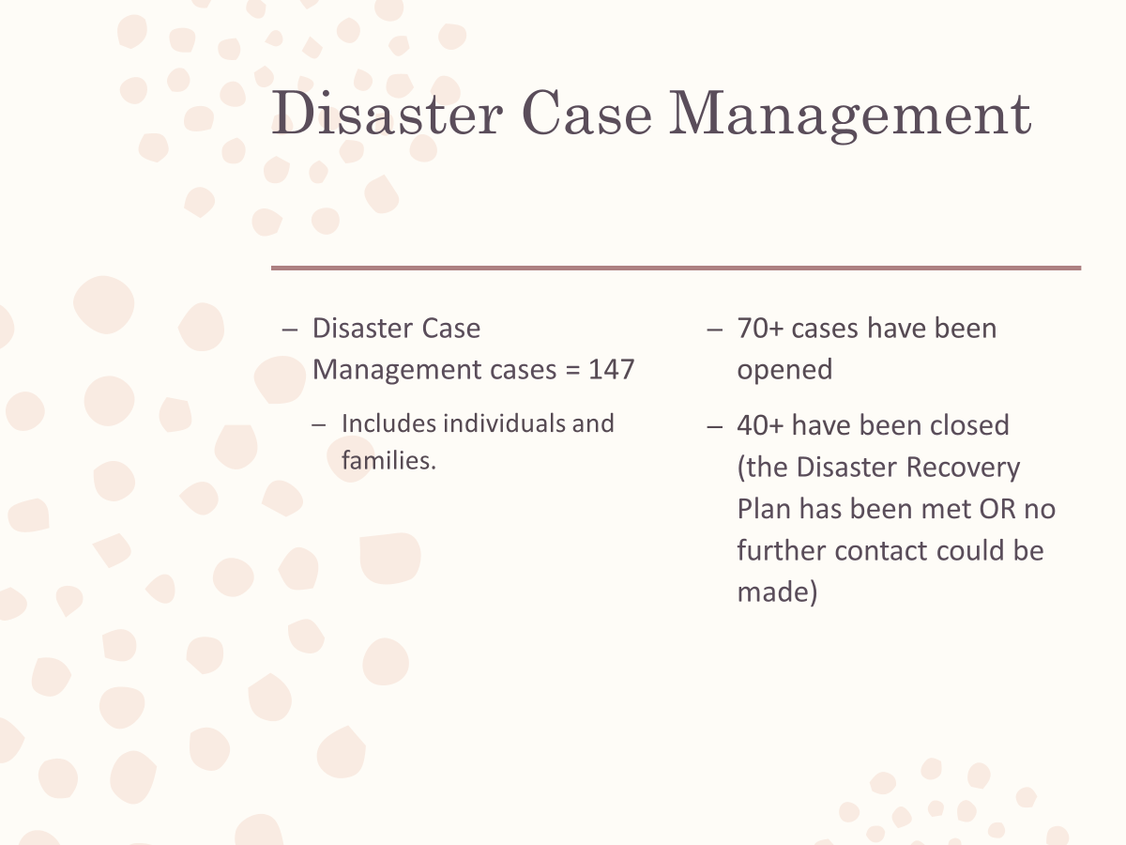

Slide 14
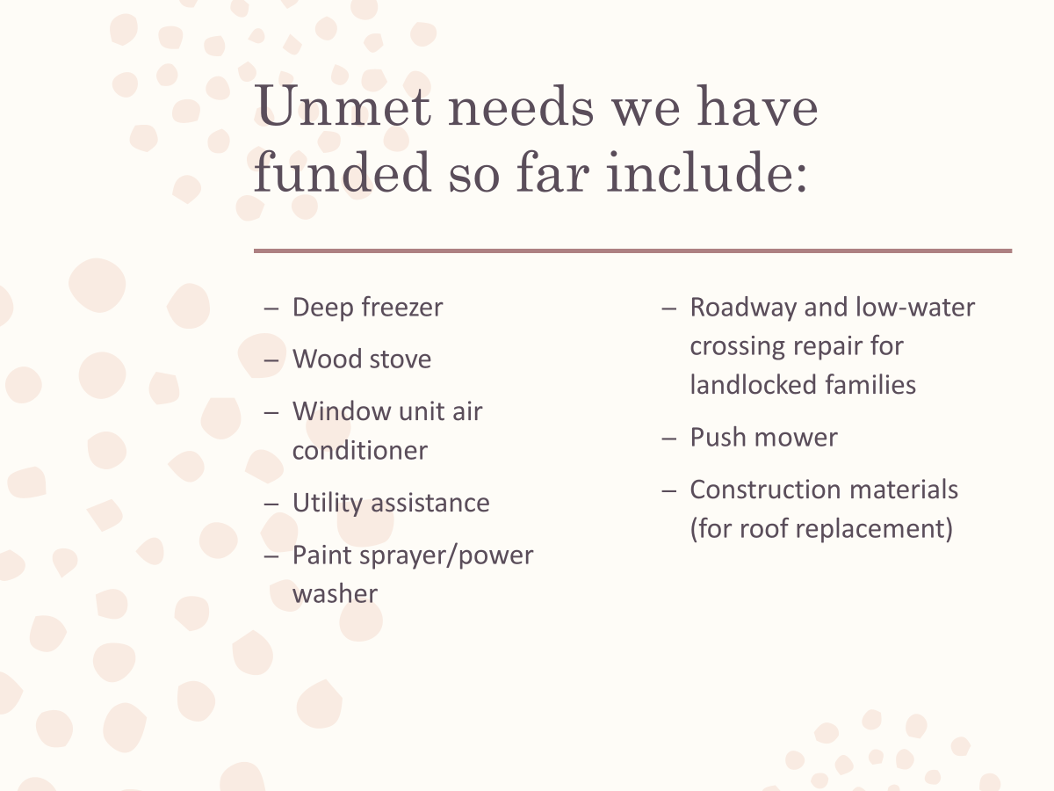

Slide 15
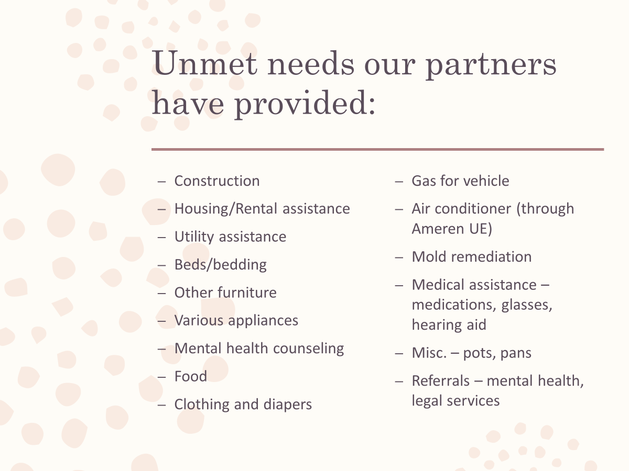

Slide 16


Slide 17

I always take time to share what organizations participated on the LTRC or donated money/goods/ services. This puts their name out into the community and can help with fundraising efforts for those organizations.
My slide “Other organizations and many, many gracious donors” covers those who may have donated something, and the information (who, what) didn’t get back to the LTRC. Businesses and individuals may donate money but request to do so anonymously. It also doesn’t list all organizations that participated in the Multi-Agency Resource Center (MARC) in January 2016.
Protecting your citizens’/clients’ identity is an important and necessary part of disaster case management. In the presentation, I shared what unmet needs we had met and still needed to meet without sharing additional information about individual cases.

Slide 18
(Portion) of the Franklin County COAD Reintroduction Meeting
The LTRC is a committee of the Franklin Co. COAD. When LTR is needed following a declared or undeclared disaster, the COAD rolls over into an LTRC only. The FRCOAD met in November 2015, DR-4250 occurred in December 2015 and the LTRC began meeting in February 2016. . .DR-4317 occurred in April 2017 and LTRC continued to meet until the final DR-4317 LTRC meeting in October 2018.
The following slides summarize the LTRC’s work from February 2016 to October 2018.

Slide 19


Slide 20
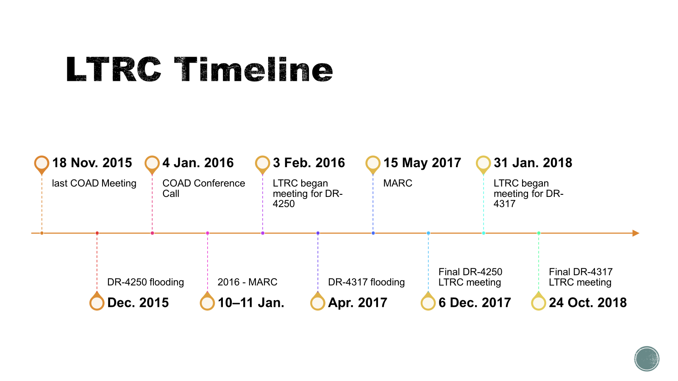

Slide 21
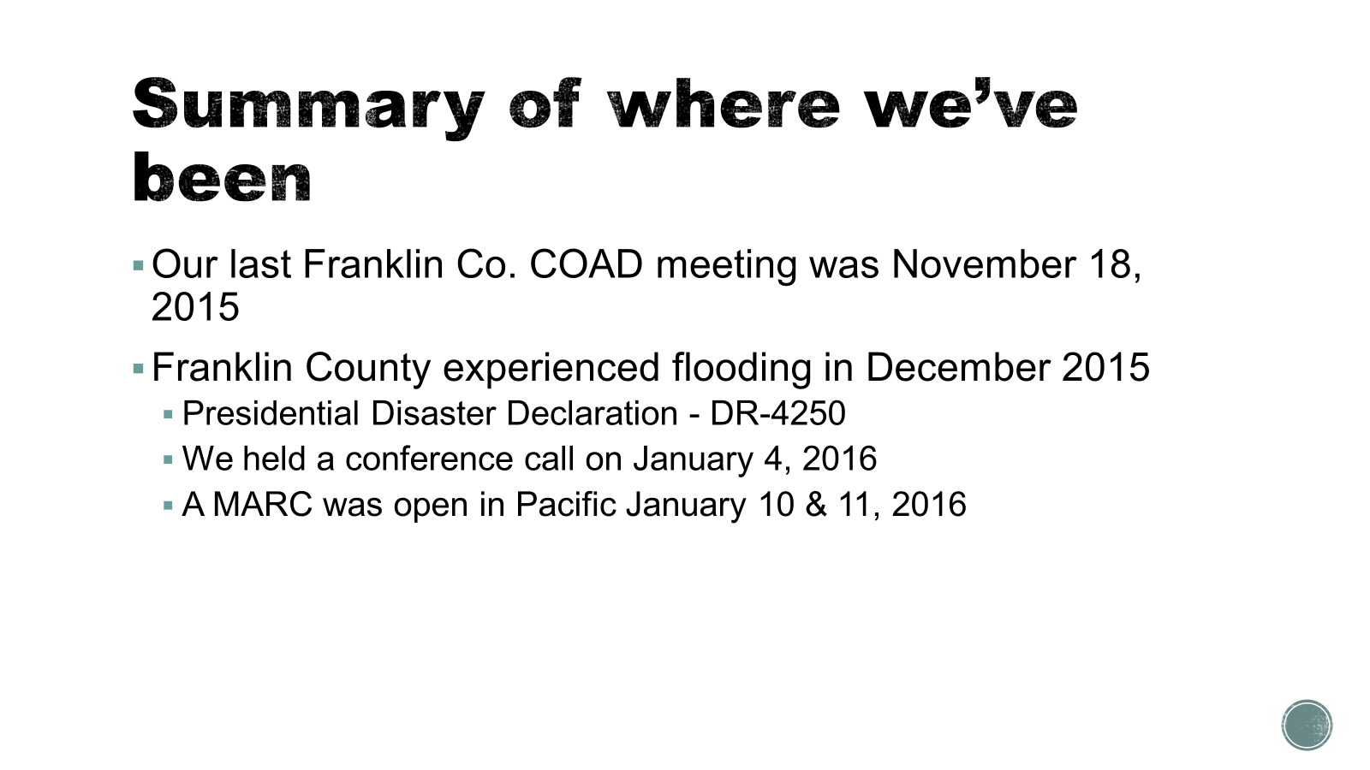

Slide 22
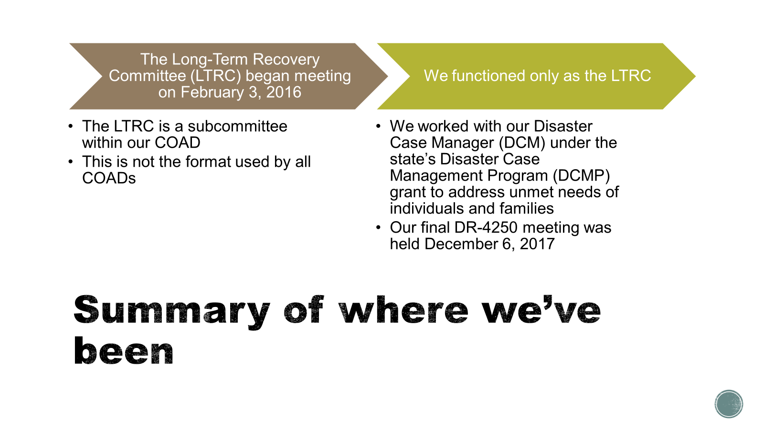

Slide 23
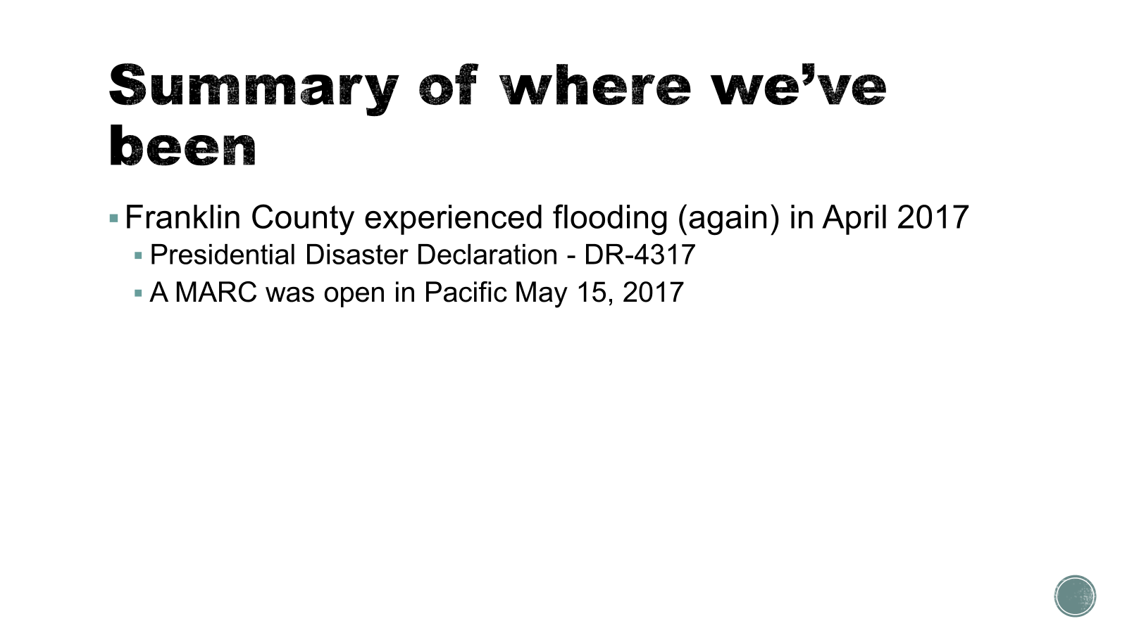

Slide 24
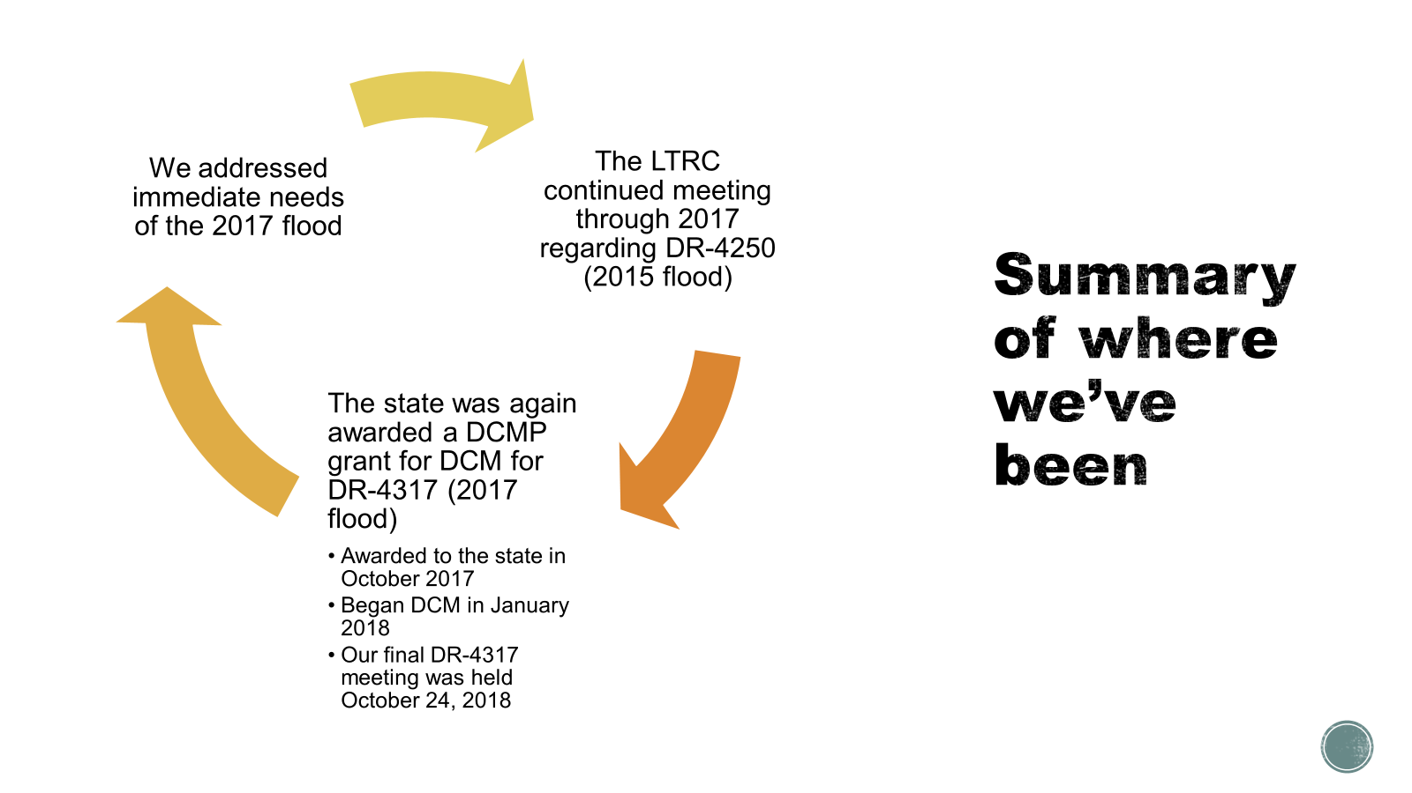

Slide 25
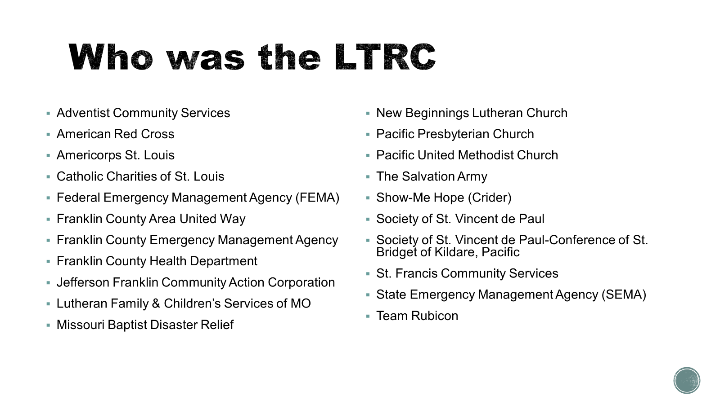

Slide 26
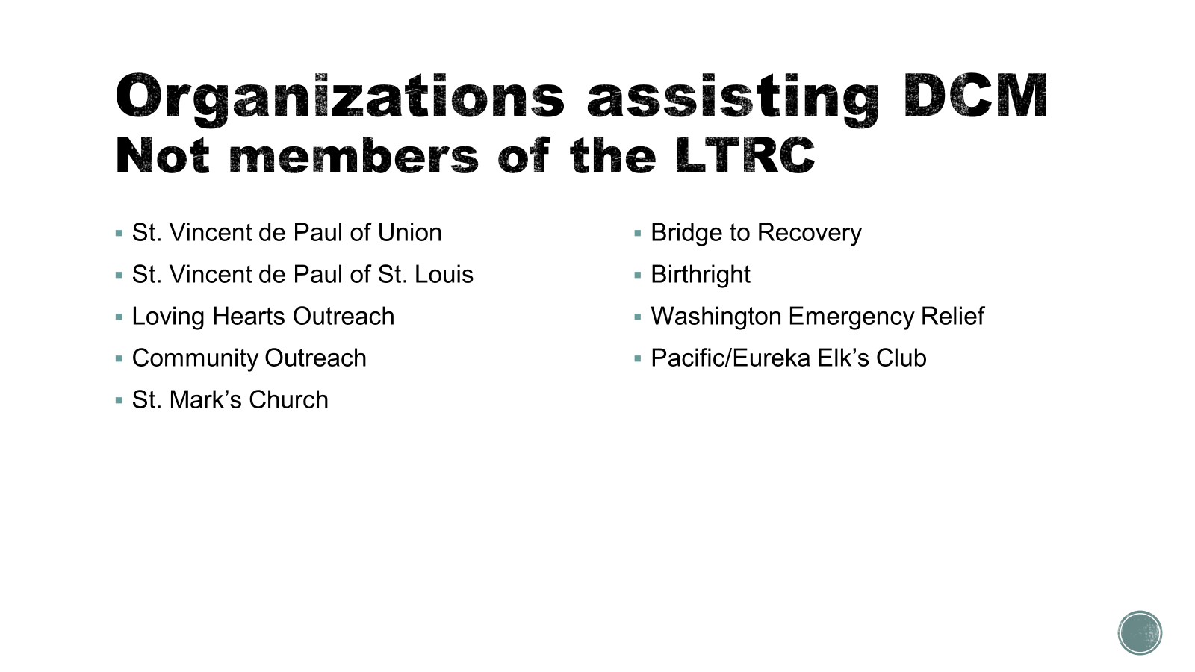

Slide 27
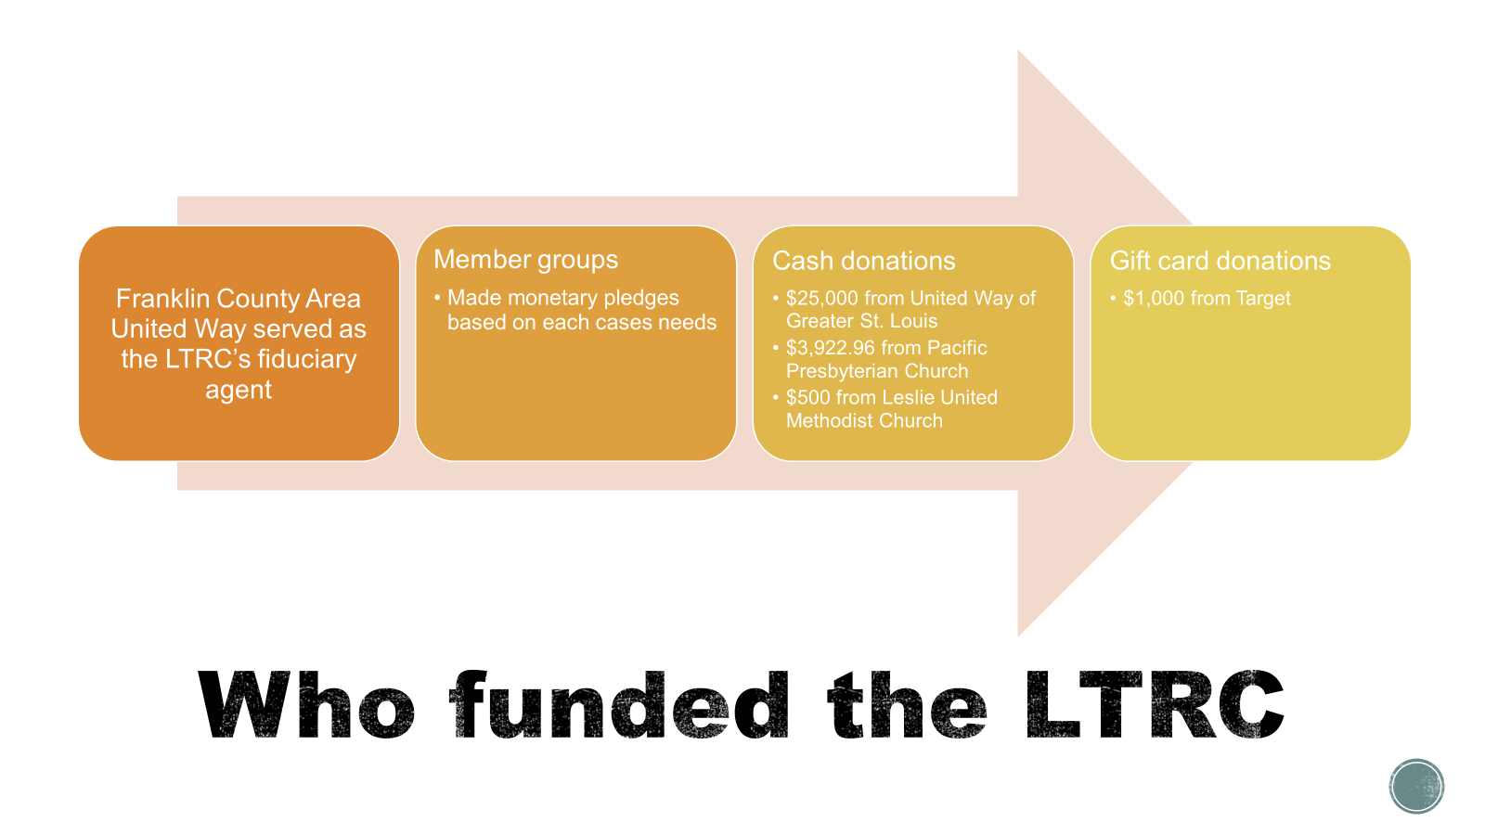

Slide 28
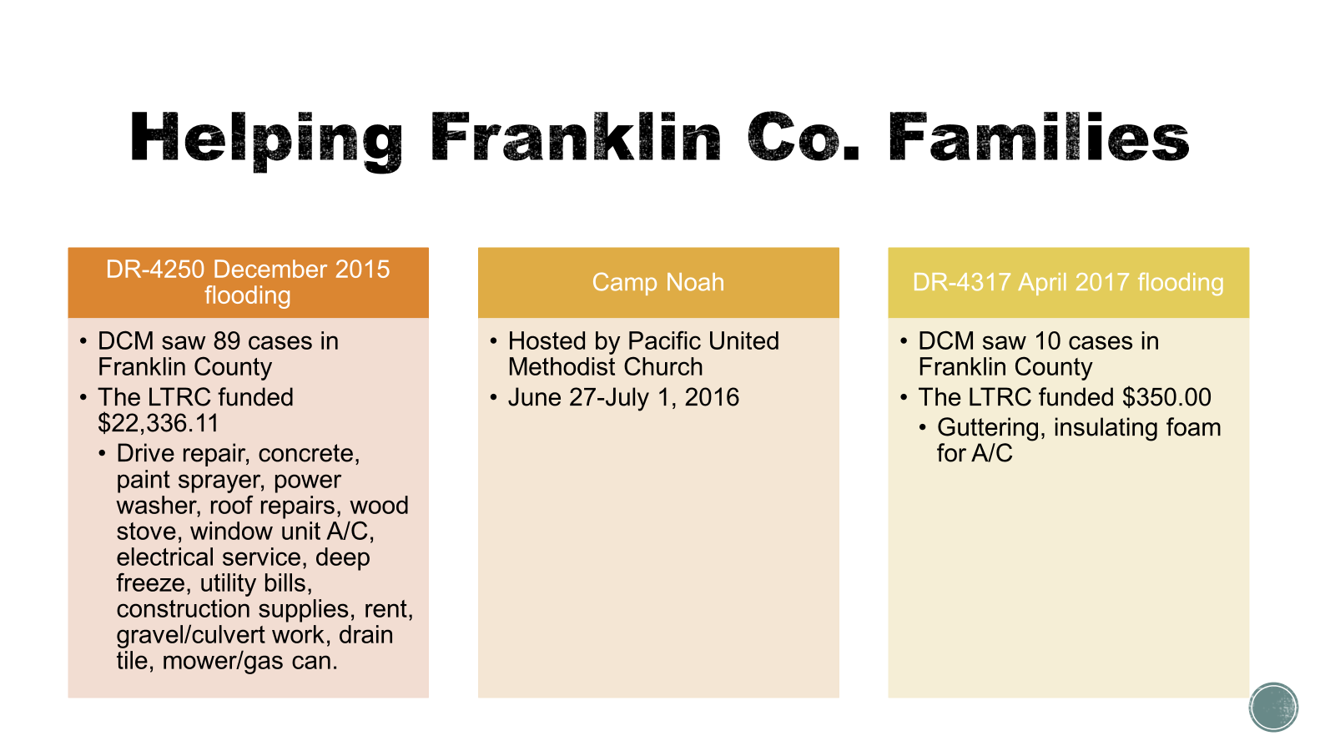

Slide 29
As I stated following the last slide presentation, I always take time to share what organizations participated on the LTRC or donated money/goods/ services. This puts their name out into the community and can help with fundraising efforts for those organizations.
It also didn’t include any organization that participated in the Multi-Agency Resource Center (MARC) in May 2017.
Protecting your citizens’/clients’ identity is an important and necessary part of disaster case management. In the presentation, I shared what unmet needs we had met and still needed to meet without sharing additional information about individual cases.
--------------------------------------
I am always happy to help with establishing a COAD or LTRC.
Please contact me if you have any questions or would like me to speak to your group.
Stephanie A. Norton
Franklin Co. Emergency Management Agency
3 Bruns Lane, Union, MO 63084
636-583-1679 sanorton@franklinmo.gov

